Slide 1
BCUS101 – Sensitivity Analysis Tutorial
A Integrated Workflow to Perform BCUS
Bayesian Calibration, Uncertainty Analysis and Sensitivity Analysis
on OpenStudio Models
July. 2016

Slide 2
Read me
Limited number of output variables:
Electricity:Facility
Electricity:Building
Gas:Facility
Heating:Gas
Heating:Electricity
Cooling: Electricity
Electricity:HVAC
Limited subset of variables
Check the “Parameter UQ Repository V1.0.xlsx” for list of variables
Sensitivity analysis only do one year of simulation

Slide 3
Overview
This tutorial will lead you through the procedures of applying BCUS - Bayesian Calibration, Uncertainty Analysis and Sensitivity Analysis on OpenStudio models.
Before you start, a functioning OpenStudio model and an EPW weather file are desired to illustrate the building and its surrounding environment being analyzed. Details of how to build an OpenStudio building model can be found here. Weather files can be downloaded here.

Slide 4
Get Started
PREREQUISITE
INSTALLATIONS
Executing BCUS typically requires the following tools and packages:
OpenStudio
EnergyPlus
Microsoft Office(Some functions will be eliminated if using Libre Office in Ubuntu, i.e. drop down list)
R
R packages
SET ENVIRONMENT
Once the prerequisite tools are installed, set up the platform variables to access executables, examples and tests.
TEST INSTALLATION
To make sure BCUS runs correctly:
Test the Ruby-OpenStudio environment
Test installation by running a simple example
SIMPLE
EXAMPLES
Step by step following the tutorial which demonstrate the basic procedure of running BCUS.
Notes:
- To use Ruby from OpenStudio Installation Package: Add path environmental variable: e.g., C:\Program Files\OpenStudio 1.6.0\ruby-install\ruby\bin
Install RubyXL: run cmd.exe as administrator, then gem install rubyXL

Slide 5
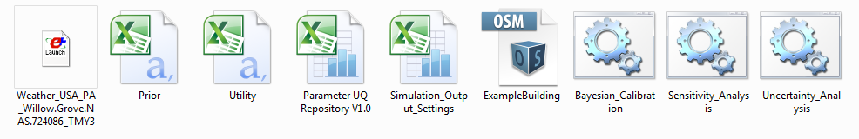
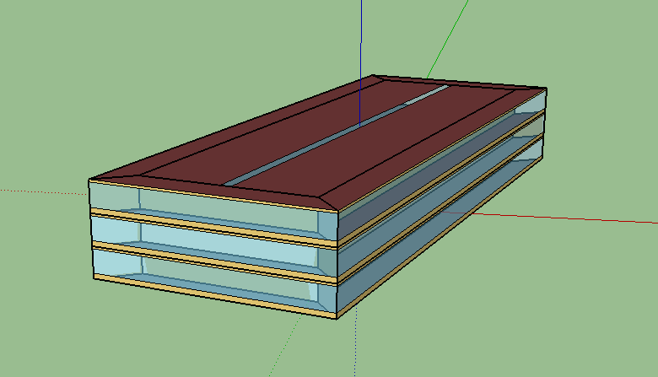
Example File
Building Description
In the Example folder, users can find the ExampleBuilding.osm model with required input files in order to run BCUS.
The example building is a 3-story, 100,000 sqft office building located in PA. It has a rectangular footprint and 50% window-to-wall ratio. The heating, ventilation and air conditioning system in the building is VAV system with DX cooling (COP =2.6). The electric resistance serves the central heating and reheat in the VAV system.

Slide 6
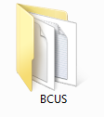
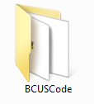
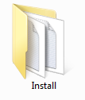
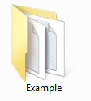
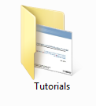
Examples
Create a Project Folder
The BCUS Package is distributed in the format of a zip folder named “BCUS.zip", the first step is to extract the folder to a local directory on your computer. The main folder contains 4 subfolders as shown below.
BCUSCode: Ruby codes to run the program
Install: Help first time users install the required packages, setup
the path and check the status of the installation
Example: The example building model and required inputs
Tutorials: Tutorial document

Slide 7
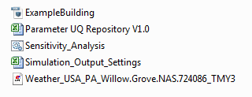
Examples: Input Files Format
Input Files
Create a project folder inside the main folder
Copy the files in: …\BCUS\Example and paste them to the project folder. Now you would see the the following files in your project folder.
After pasting the five required input files for sensitivity analysis, replace the ExampleBuilding.osm with your building model; replace the .epw file with the weather file for your building’s location.

Slide 8
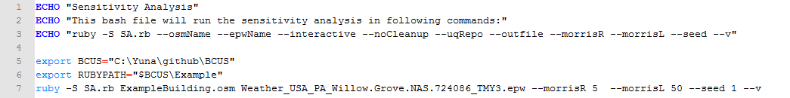
Step 1: Edit Executable Bash/Batch Script
Open Sensitivity_Analysis.bat file using any available text editor:
Replace current directory with your “BCUS” directory, such that:
export BCUS =“<your main folder directory>”
Replace default file names with the name of your building model and weather file.
You can save the modified bash script with a new name, such as Run_SA.bat or just keep the old name.
Replace with the directory of your main folder
List of inputs. Add ‘--help' for detail explanations
Will use default values if left blank in the input
Replace with the name of your
building model
Replace with the weather file of your building model

Slide 9
About the Bash Script
--osmName: The name of the OpenStudio model (.osm)
--epwName: The name of the weather file(.epw)
--interactive: If true, there will be dialogue between the user and the program
--noCleanup: If true, intermediate files will be kept
--numLHS: The number of Latin Hypercube Sampling runs
--uqRepo: The name of the UQ parameter repository in the directory
--outfile: The name of the simulation output setting file (.csv)
--morrisR: The number of paths for the Morris method
--morrisL: The number of levels for the Morris method
--seed: Need to be an integer. If same, the sequence of the samples will be the same
--verbose: If true, run in verbose mode with more output info printed
--help: Display help

Slide 10
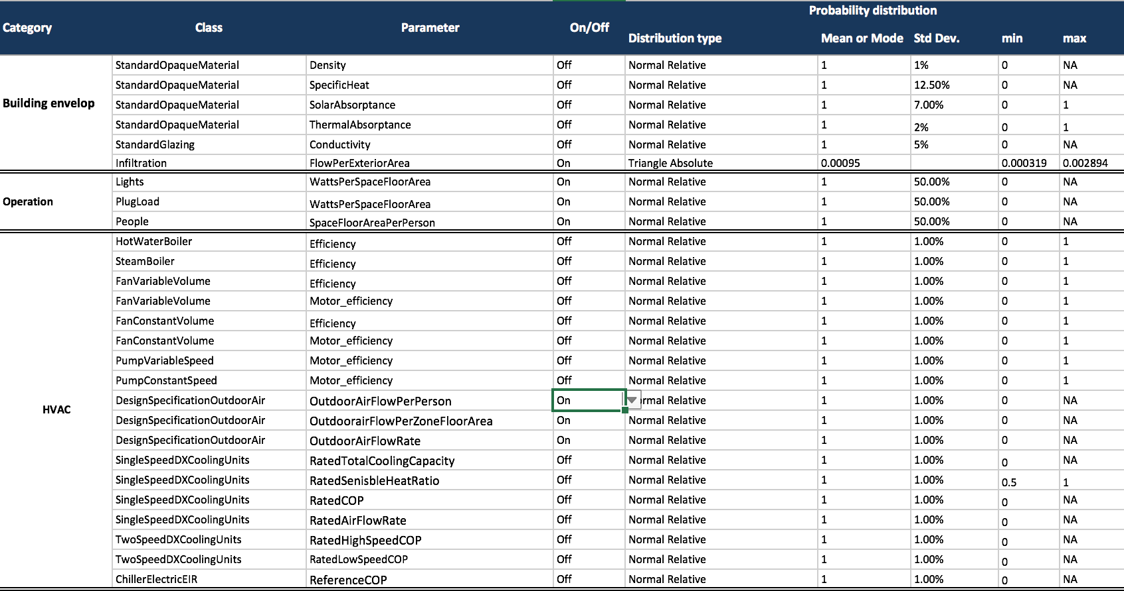
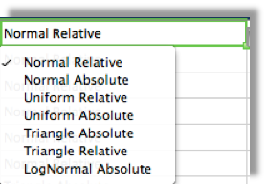
Step 2: Check the parameter UQ-Repository
Turn on parameters which you want to investigate in the sensitivity analysis in the Parameter UQ Repository V1.0.xlsx file.
Leave the other setting as default unless you have the confidence in the knowledge you have on a specific parameter.
Turn on/off sources
of uncertainty
Default probability distribution value

Slide 11
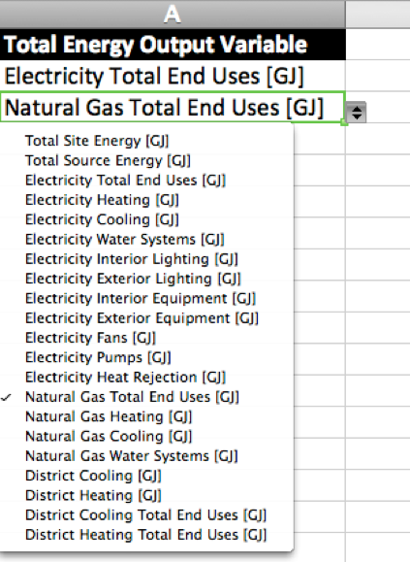
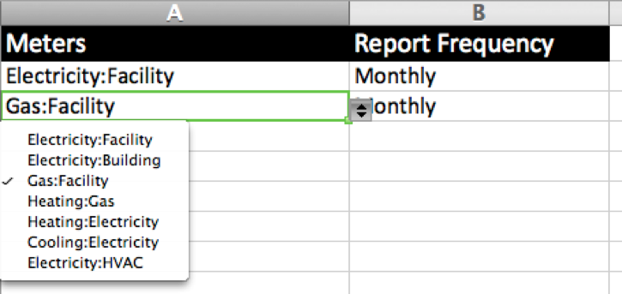
Step 3: Outputs and Report Frequency Settings
Use Simulation Output Settings.xlsx to setup simulation outputs:
Navigate to the TotalEnergy tab to add total energy output variables using the dropdown list
Navigate to the Meters tab to add meters and report frequency using the dropdown list
.

Slide 12
Step 4: Run Executable Bash Script in the Terminal
Launch the Terminal in your operating system:
For OSX – Press Command + Space and type terminal and press Enter
For Linux – Open the Dash by clicking the Ubuntu icon in the upper-left, type terminal, and
select the Terminal application from the results that appear.
or simply hit the keyboard shortcut Ctrl-Alt+T.
For Windows – Click Start, in the search box type cmd and press Enter
Navigate to your project folder
Click the cursor in your Terminal/cmd type:
cd <your project folder directory>
For example,
cd /Users/username/Documents/OpenStudio/BCUS/Example
Run the bash script you just modified by type:
Sensitivity_Analysis.bat (Windows)
sh Run_SA.sh (Linux/OSX)

Slide 13
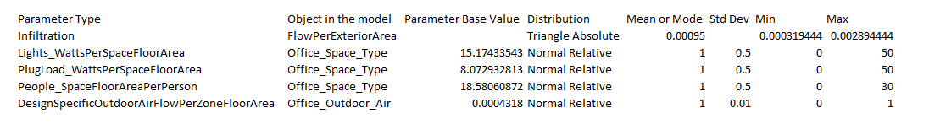
Step 5:Generate Distributions of Uncertain Parameters
The first step of the sensitivity analysis program is to generate a distribution table of uncertain parameters, which you can find it at ../SA_Output/UQ_building_name.csv
Before moving to the next step, open the table, finalize parameters in the table, save and close the file. DO NOT remove the first row.
The example building model includes five parameters in the sensitivity analysis:
infiltration rate, lighting load, plug load, occupancy load, and design outdoor air flow rate.

Slide 14

Design Matrix and Simulation Runs
In the second step, the program will generate a design matrix based on the Morris method (Morris 1991). The design matrix contains the value of parameters generated from distributions specified in the UQ table.
In the third step, the program runs certain number of OpenStudio models which have been generated based on the design matrix.
Morris, M. D. (1991). Factorial sampling plans for preliminary computational experiments. Technometrics, 33(2), 161-174.

Slide 15
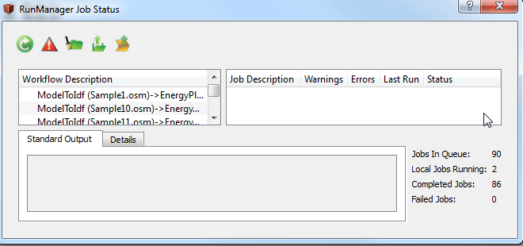
OSM RunManager
The program will automatically start the OSM RunManager and run the generated .osm files.

Slide 16
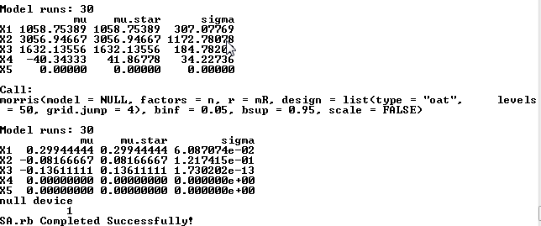
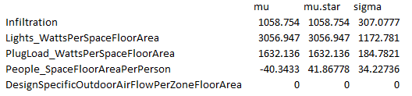
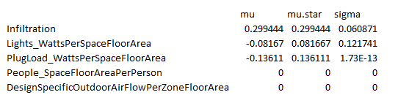
Check SA Results in the Terminal
After simulations have completed, the terminal will print out parameters with their sensitivity measures on each line. The user can also find the output in the SA_Output folder. Ranking of parameters is based on mu.star.
SA on Total Electricity Use
SA on Total Gas Use

Slide 17
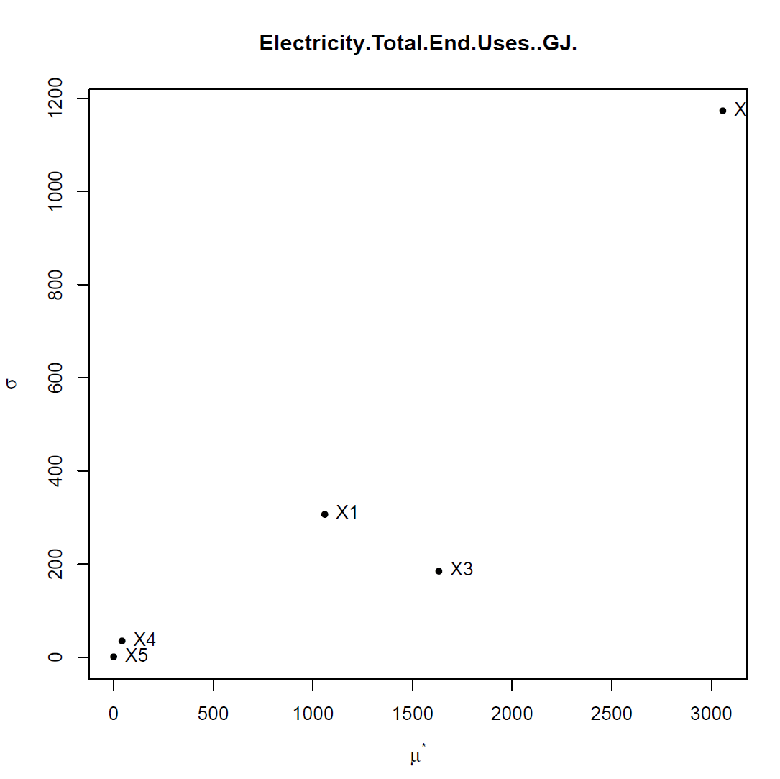
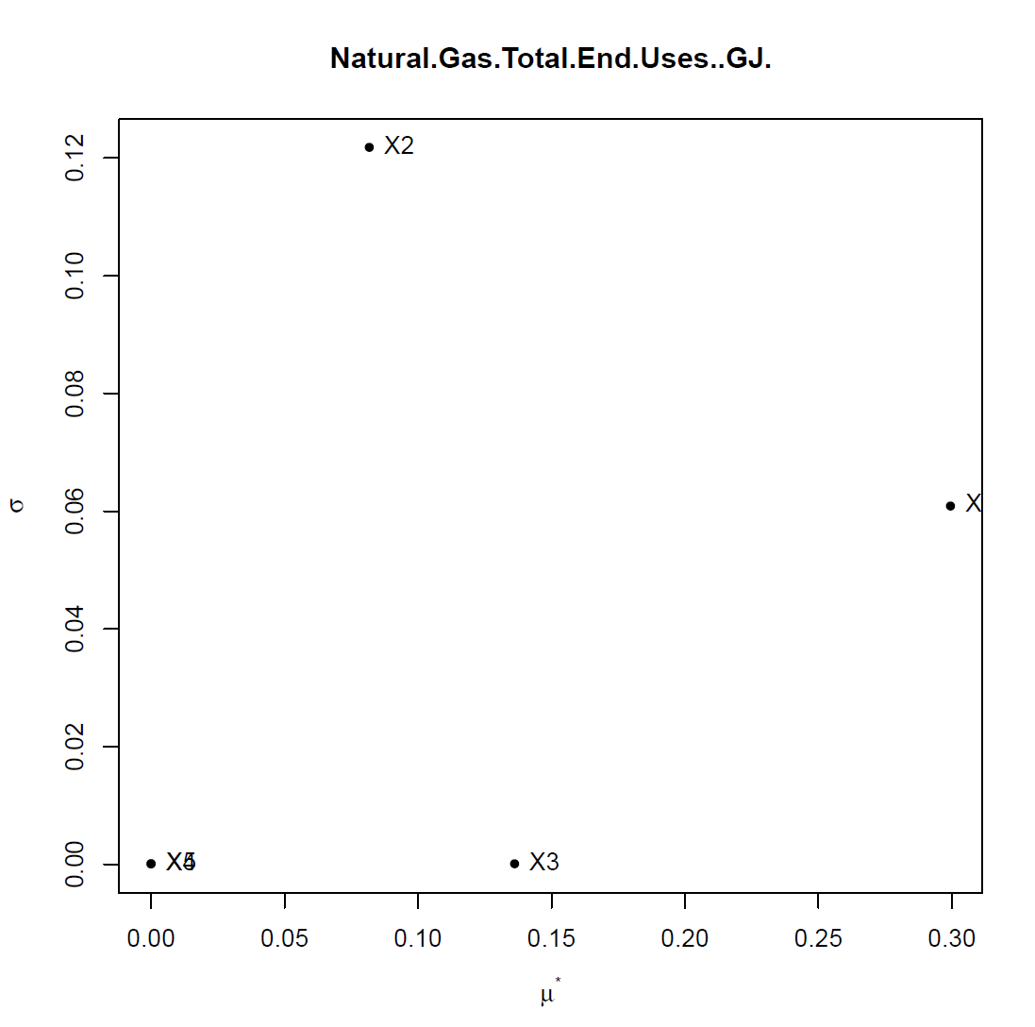
Check SA Results in Output Folders
A Sensitivity_Plots.pdf file will be saved to ../SA_Output. Raw results from simulations are saved to ../SA_Simulations. Open the pdf file and check the plot of the sensitivity analysis.
Note:
The lower ranked parameters in the sensitivity analysis result are not stable upon repetitive runs of the same input settings, that is, parameters near the origin in a sensitivity plot would fluctuate upon each runs.
The parameter near the origin in the sensitivity plot does not necessarily imply its sensitivity measures to be 0, due to the scale of the plots.

Slide 18
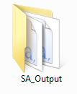
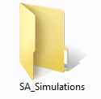
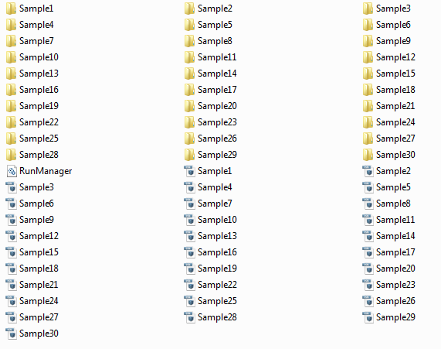
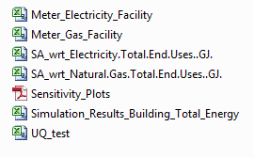
Output Files
A Sensitivity_Plots.pdf file will be saved to ../SA_Output. Raw results from simulations are saved to ../SA_Simulations.

Slide 19
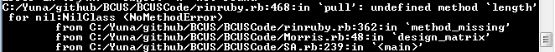
Trouble Shooting
If error message says “in pull: undefined method ‘length’ for nil:NilClass” , first check whether uncertain parameters have been turned on correctly in the Parameter UQ Repository V1.0.xlsx file (step 2).
If all the uncertain parameters have been turned on correctly, check whether the os model has corresponding uncertain paramters in the correct format that is supported by BCUS.

